Slide 1
INTEGRATION OF BUILT-IN MODULES

Slide 2
MODULE TO BE COVERED
Image slider
http://www.menucool.com/javascript-image-slider
http://www.devtrix.net/sliderman/
http://amazingslider.com/
Tooltip
http://jsbin.com/owupil/10/edit
Dhtmlx
http://www.dhtmlx.com/docs/products/dhtmlxCalendar/

Slide 3
Dhtmlx
Step 1
../dhtmlxcanlendar/codebase/dhtmlxcalendar.css
../dhtmlxcanlendar/codebase/skins/dhtmlxcalendar_dhx_skyblue.css
../dhtmlxcanlendar/codebase/dhtmlxcalendar.js

Slide 4
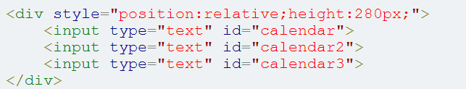
Dhtmlx
Step 2
Step 3
Note: you should call doOnLoad() any javascript event otherwise your calendar not show

Slide 5
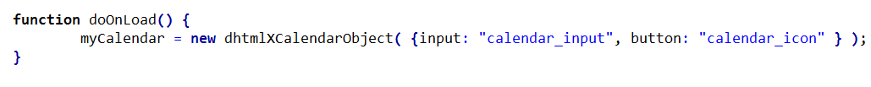
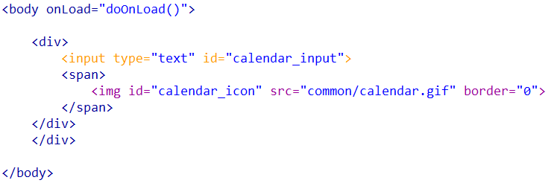
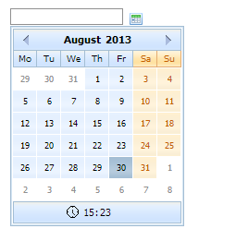
Dhtmlx
Icon

Slide 6
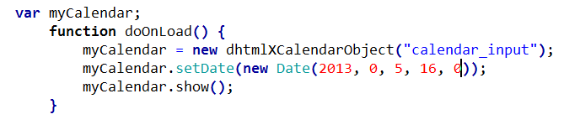

Dhtmlx
Custom Date

Slide 7
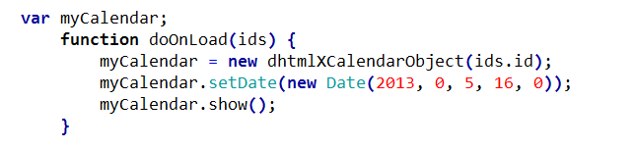
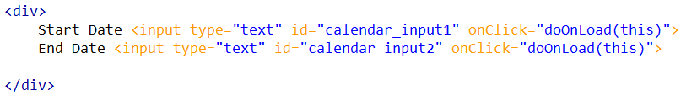
Dhtmlx
Multiple Input Fields

Slide 8
TinyMCE - JavaScript WYSIWYG Editor
TinyMCE is a platform independent web based Javascript HTML WYSIWYG editor control released as Open Source under LGPL by Moxiecode Systems AB.
TinyMCE has the ability to convert HTML TEXTAREA fields or other HTML elements to editor instances.
TinyMCE is very easy to integrate into other Content Management Systems.
Facebook
The 500+ million ppl on Facebook has access to TinyMCE. Facebook is using TinyMCE in their "Notes" and "Facebook Questions" sections. Wordpress
The most popular and widespread blogging software uses TinyMCE as the default editor, they have millions of downloads for each new release. Oracle
TinyMCE is used to enhance the Oracle Beehive Collaboration software. Microsoft
Various Microsoft forums (MSDN etc) uses TinyMCE as their default forum content editor. Apple
TinyMCE is used by Apple in some of their online applications. IBM
IBM uses TinyMCE in their Web Content Management software. Joomla
http://www.tinymce.com/

Slide 9
Php grid
http://phpdatagrid.com/examples/phpGridx/examples/basic_phpgrid.php?iframe=true&width=850&height=500
https://datatables.net/

Slide 10
Some Useful Links
http://spyrestudios.com/22-useful-html5-css3-form-tutorials/
http://www.iconarchive.com/
https://www.iconfinder.com/
http://all-free-download.com/
http://www.1stwebdesigner.com/freebies/45-free-html-css-templates-2011-2012/
http://speckyboy.com/2014/03/07/30-free-responsive-html-templates/

